Slide 1
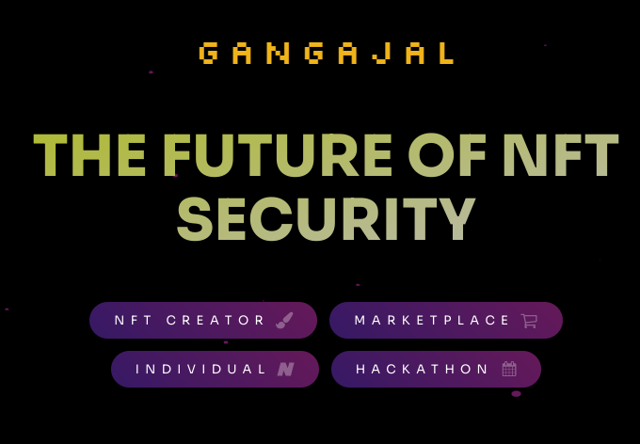

Slide 2
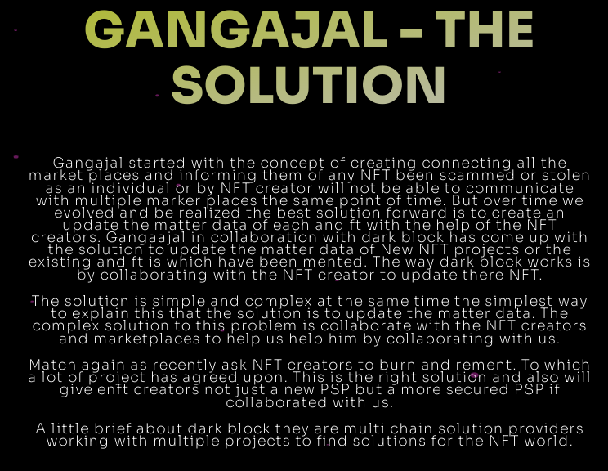

Slide 3
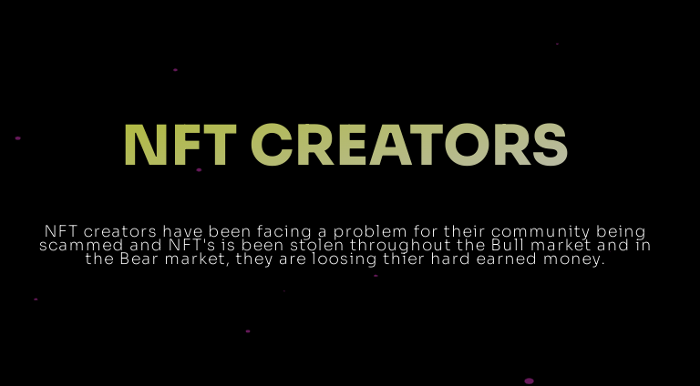

Slide 4
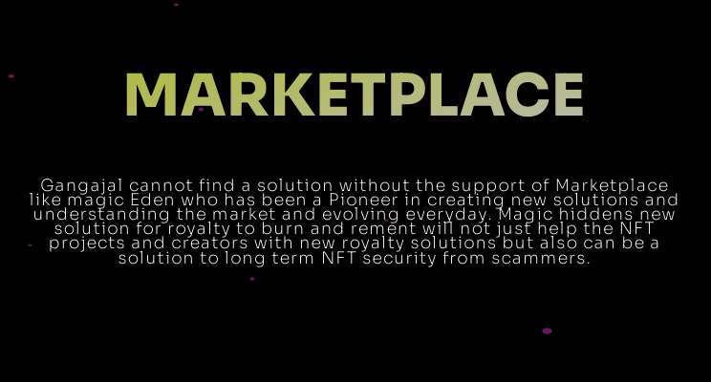

Slide 5
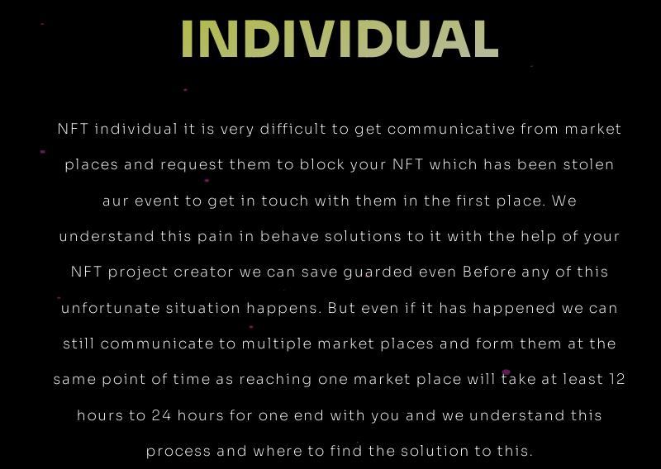

Slide 6
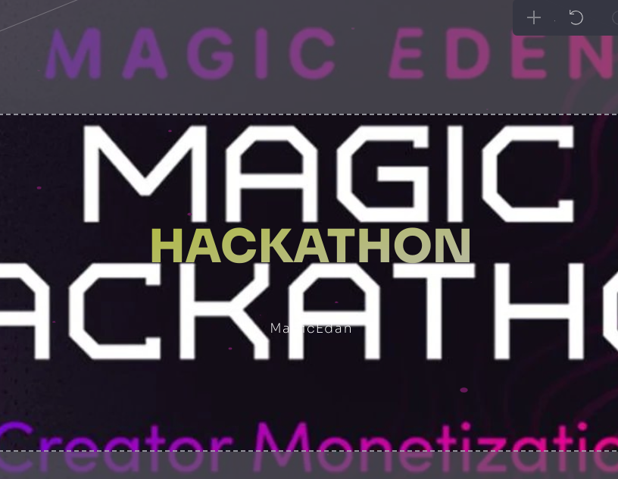

Slide 7
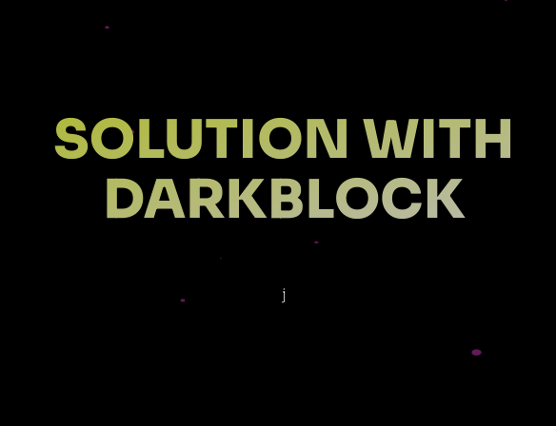

Slide 8
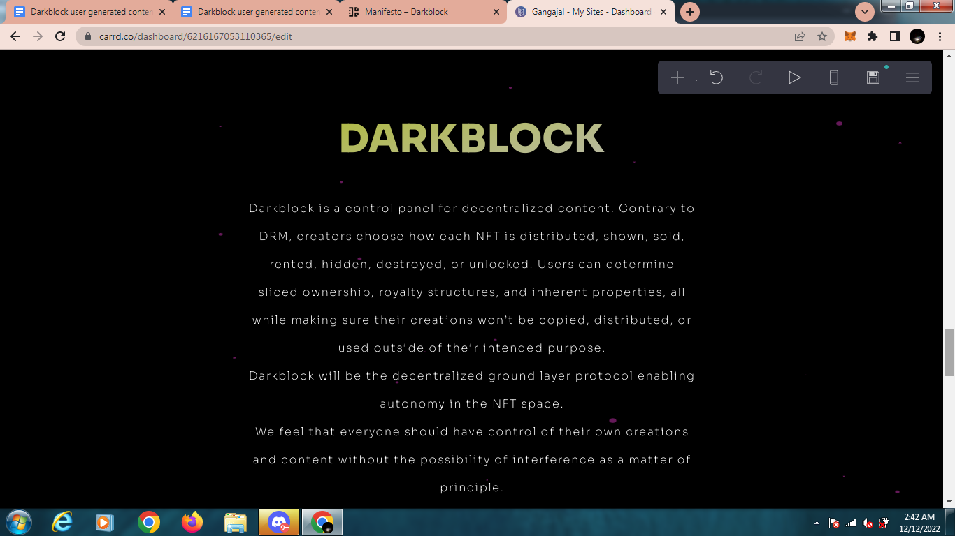

Slide 9
DarkBlock added a new parameter “type” where they can pass in a string. Gangajal can name it “The NFT Is stolen/ scammed” for your protocol.
Gangajal will need to pass in the address of the person claiming their NFT is stolen as the creator address and then ask them to generate a signature as shown in the docs on that page.
Stolen NFT Flags Listing
To retrieve all Stolen NFT Flags reported by users DarkBlock will build a custom query.
Darkblock Protocol Requests
Once Darkblock unlockable content is detected they need to construct a session token to access the content. This session token is a combination of the epoch timestamp (milliseconds), the signature of the concatenation of the current epoch timestamp and the wallet address of the user, and the chain.
One session token is needed per chain, and can be cached, as they do not currently expire. They will be prone to expiration in the future, the rules around this will be coming soon based on partner feedback.

Slide 10
Here is the format of the session token: <epoch millis>_<signature>_<chain>
Example:
Signature of 16529845012790x438cba7e454b59a9f897d4731fd3eaef37160c0a
Becomes the following session token: 1652984501279_0x23ddc5b8767a3c2c7c9bab3bdcb86c88a328d21b214e2edad91c6d40b4ad34860c99cfbbf06381c718d8ef3c8068145834ba9a2c8bd442afae7468fef1d10a2f1c_Ethereum
The ArtId can be taken from the Darkblock info response and combined with the session token, owner wallet address, NFT Contract and Token Id, and platform to construct a Gateway request.
https://gateway.darkblock.io/proxy?artid=&session_token=&token_id=&contract=&platform=
Example:
https://gateway.darkblock.io/proxy?artid=9b3aa571-d42f-4699-b09f-6b6c76dab994&session_token=1652985436749_0x1c52329bee2409530b07ddce694df6e75671c3b51bde4aa02f25630f99c369e21d420301b7b7d89eb892b389f1fe32a262c3eae296d2ae81bc05805aca46d8f21c&token_id=30553606573219150352991292921105176340809048341686170040023897669293200900097&contract=0x495f947276749ce646f68ac8c248420045cb7b5e&platform=Ethereum
(not a working example)
For Ethereum compatible chains we can use this handy-dandy signature tool that allows you to paste in some arbitrary text and create a signature with Metamask:
https://random-crap-public.s3.amazonaws.com/sign.html

Slide 11
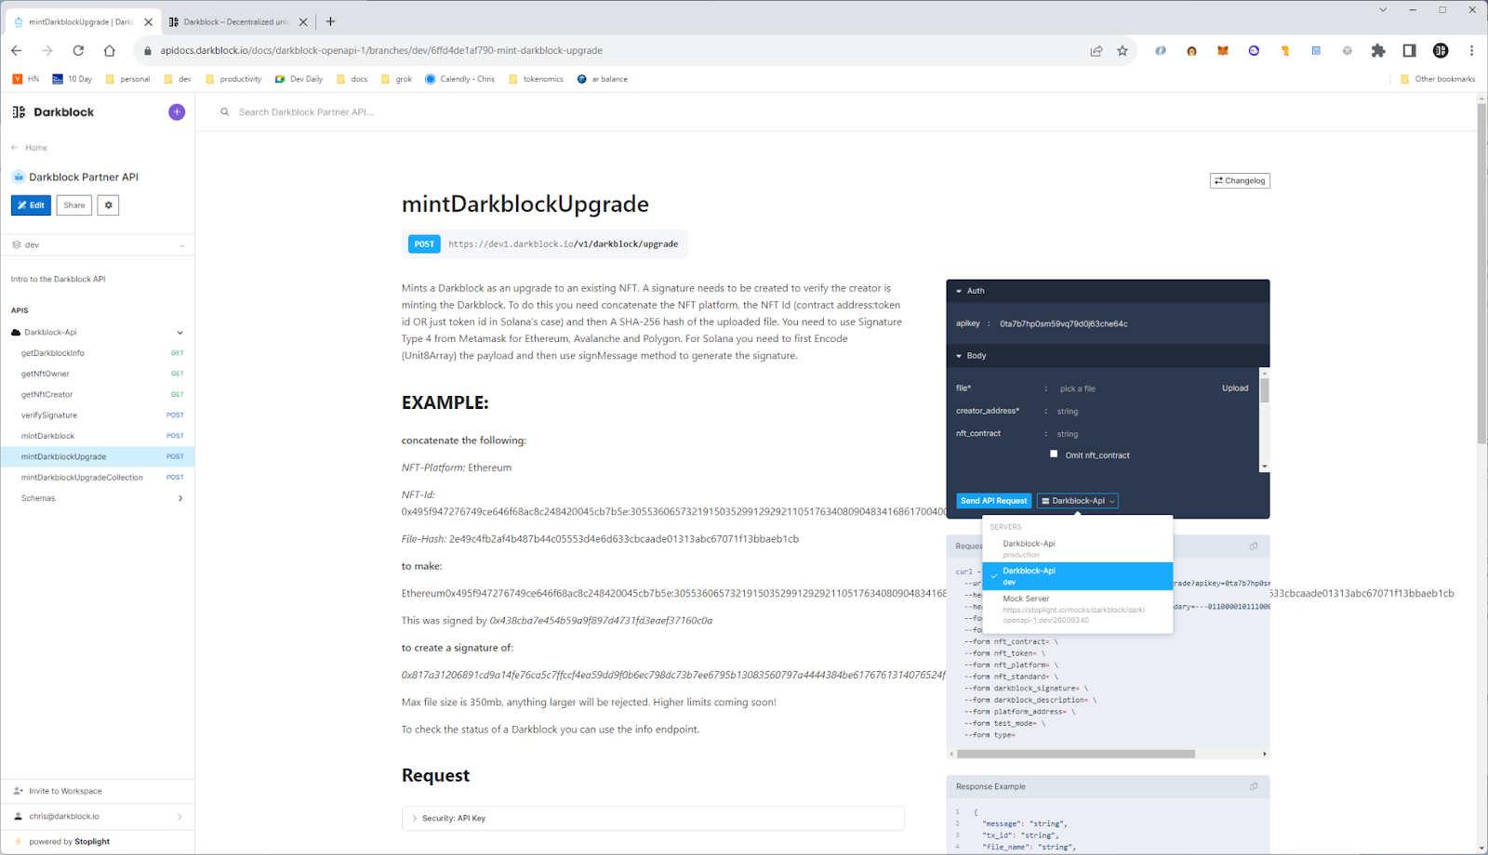

Slide 12
